Slide 1
“Stay Curious” - Steve Jobs

Slide 2
CrowdCart

Slide 3


What It Does
You need some things
You write down some things
You push a button
The most optimal, personalized errand run, designed to save you time and money
CrowdCart processes
Potential Trip 1
Potential Trip 2
Potential Trip 3
Notes:
Walk through the process of a user using CrowdCart

Slide 4



Why Use CrowdCart?
Notes:
Let CrowdCart do the thinking for you. It saves you money by finding you the lowest prices of stores around you, and it saves you time trying to figure out where to buy everything you need. You also contribute to your community by scanning your receipt and helping to let the people around you know about the best deals and lowest prices. CrowdCart makes it easy to contribute: All you have to do is snap a picture of your receipt and tap the items you purchased, and we do the rest.

Slide 5

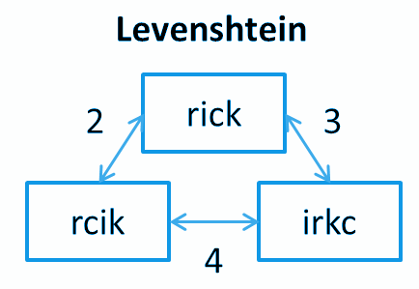


How It Works
Notes:
We use Google-powered OCR to parse receipt text, and then find the minimum Levenshtein distance to classify our parsed text as one of a number of predetermined products. We also use Google Places API to populate the database with a list of nearby stores and their distances from the current location. CrowdCart is able to synthesize these to compute a score for each product at each location.

Slide 6


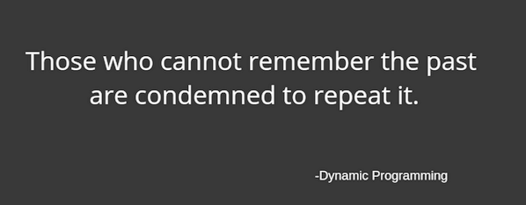
How It Works
Notes:
When you want to figure out where to shop, it takes the items on your shopping list and compares them with nearby price in the database. It then uses a dynamic programming algorithm to find the optimal classification of products to the stores around you, and recommends which items to purchase at which stores. In doing so, it takes into account price and distance from the current location. It also considers clustering products into the minimal number of different stores, and considers your preferences: would you rather drive the extra mile to save those few cents?

Slide 7



Rollout and Data Seeding
Notes:
We need data. College students need money. It’s a match made in heaven. By rolling out CrowdCart first to college campuses, we will be able to grow our popularity and our data at the same time. College students will share the app with their friends and will be motivated to help each other save money. As a result, we will be able to rapidly grow our databases in order to improve our suggestions. We would also like to scrape pricing data from websites of major providers, but crowdsourcing made easy provides a sense of community and up-to-date information that is unparalleled.

Slide 8
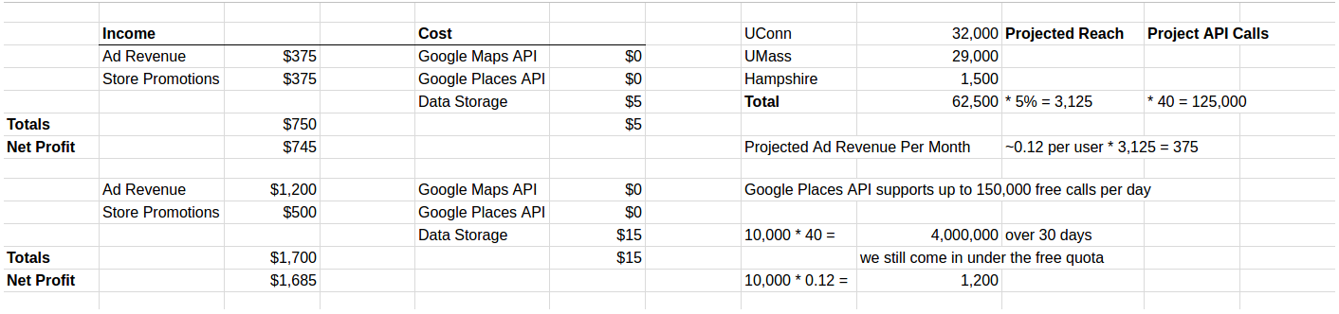
Incomes and Costs

Slide 9
Looking Forward
Incentivize Uploading Receipt
Improved receipt parsing, item and store recognition
Improved algorithm for price determination based on weighted average
Grow user base
Improved user interface
Partner with stores for advertising revenue

